Slide 1
Disaster recovery mechanism with active storage replication and DNS failover in cloud Virtual Machine
Domain: Networking, Web Development
BATCH A15:
Kolla Priya(211418104129)
Kuricheti Spoorthi(211418104136)
Balasa Chenchu Sai Vyshnavi(21141810)
Project guide: Mrs. Devi R

Slide 2
ABSTRACT
The Domain Name System (DNS) is a vital service in the Internet. Much more than a simple translation mechanism, it also allows higher profile functionalities such as load balancing and enhanced content distribution.
In the scope of cloud computing, DNS is foreseen as an elastic and robust service, supporting failover mechanisms, decentralised configuration and multi-tenant isolation.
The problem arises where a particular DNS is not able to point an IP address of the server because of heavy traffic, DDoS attack, system crash and much more reasons.
During this period there are huge chances for an organization to be a victim of huge, valuable data loss and have a downtime for a certain period.
This will cause a billion dollar business impact and risk of losing data.
To overcome this we come up with an approach of DNS Failover with active Replication which is a solution designed to help keep the services online and prevent from Data losses.
When systems and services go down DNS failover is used to direct the users to another resource with little to no disruption which has active replication of Data with the current prod Server.
The backup server/ Replicating server is named as Contingency server (CNR) which has a active storage replication with the Production server preventing Data loss.

Slide 3
TECHNOLOGY STACK
->
Database Engine
POSTGRESQL
Storage Mount
->
NAS based Virtual Storage Disk (AZURE)
Server go-live providers
->
Apache KNOX, Nginx, Gunicorn
Framework
->
DJANGO
Automatic DNS Routing Port
->
10101 (Subject to change)
+
Azure VM
PYTHON + shell scripting
Languages/ Interfaces
->

Slide 4
MODULES
Resource group creation
Create a Azure AD group
Process DNS name server
Provision PROD and CNR servers
Configure Test Web page
Scripting Django based website to test the server activeness
Configure Apache knox for DNS failover
Test and setup failover and replication
Host server using Nginx and Gunicorn
Closs validate replication &failover

Slide 5
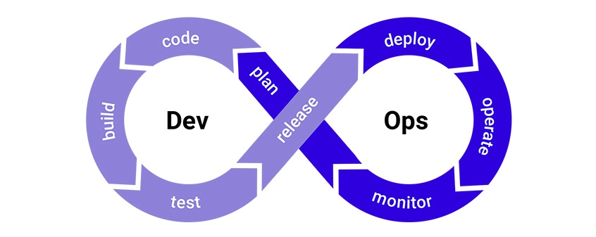
SDLC MODEL
DevOps deployment methodology

Slide 6
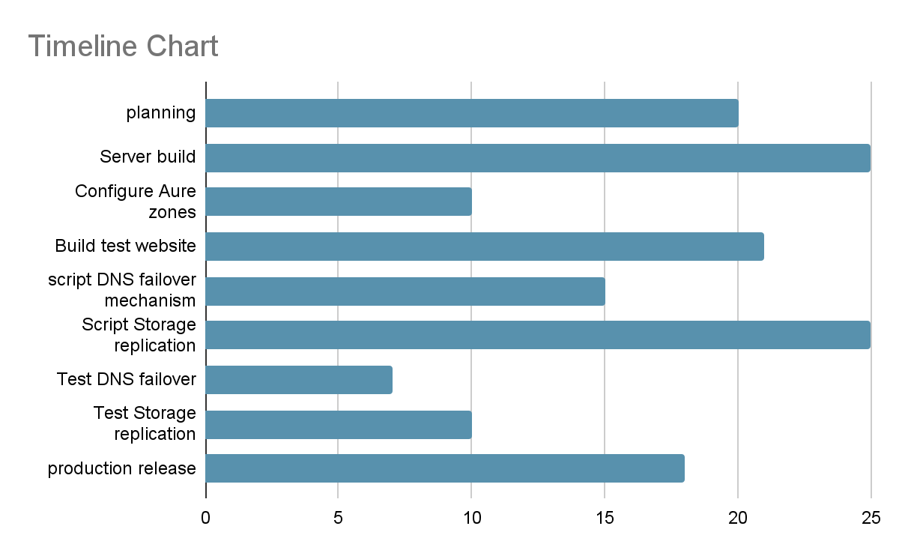

Slide 7
THANK YOU

